Slide 1
Simulation and Modeling
CSE4131_CSE4132

Slide 2
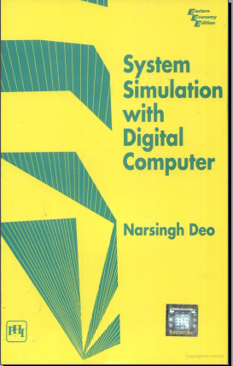
Few examples…
Reference Book:
System Simulation with Digital Computer
By- N. Deo
Chapter No.: 1 (Introduction)

Slide 3
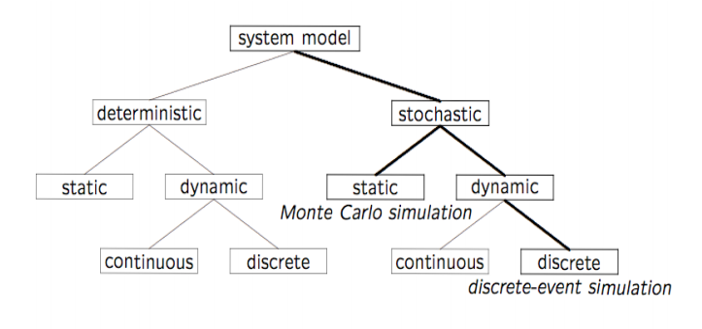
Classifications

Slide 4
An other Example
Simulation of a Chemical Reactor
Its an example of a continuous system
Its an example of dynamic system
Question may come:

Slide 5
Problem statement
In a chemical reactor:
There are two substances: A & B
A + B = third chemical substance C
Its known:
1 gram of A + 1 gram of B → produces 2 grams of C
The rate of formation of C is:
proportional to presence of A & B
Backward reaction - decomposition of C back in to A & B:
The rate of decomposition proportional to the amount of C present in the reactor

Slide 6
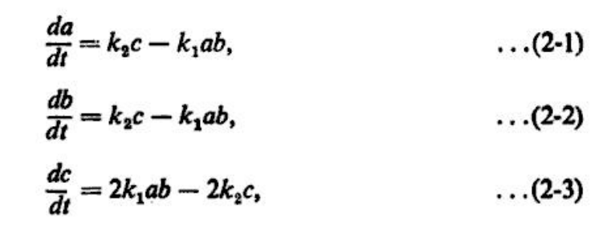
Simulation of a Chemical Reactor
Let a, b & c … are quantities of A, B & C at any time t
Then the rate of increase…

Slide 7
Simulation of a Chemical Reactor
Given the values of the
constants k₁ and k₂ and
the initial quantities of the chemicals A and B (and C = 0),
we wish to determine how much of C has been produced as a function of time.
Determination of the rate of such chemical reactions is important in many industrial processes
A straightforward method of simulating this system is to start at time zero and
increment time in small steps of ∆t.

Slide 8

δt
B
A
C = 0

Slide 9
Simulation of a Chemical Reactor
We assume that the quantities of chemicals remain unaltered during each step and only change 'instantaneously' at the end of the step.
Thus the quantity of A (or B or C) at the end of one such step is given in terms of the quantity at the beginning of the step as
Identical equitation can be written for b(t+∆t) and c(t+∆t)

Slide 10

Simulation of a Chemical Reactor
Suppose we want to do the simulation for a period T
We will divide T in to a large number N of small periods ∆t
That is,
At the time zero, we know a(0), b(0) and c(0)
We also know k₁ & k₂

Slide 11

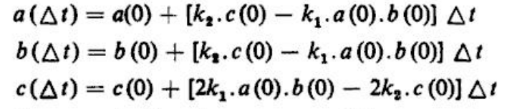
Simulation of a Chemical Reactor
From these values we compute the amount of chemical at the time ∆t :

Slide 12
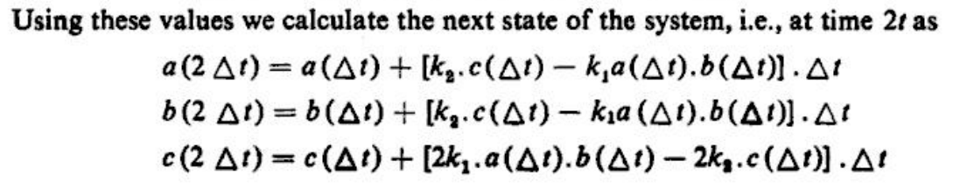
Using the steps we calculate 3∆t, 4∆t … N∆t → T

Slide 13
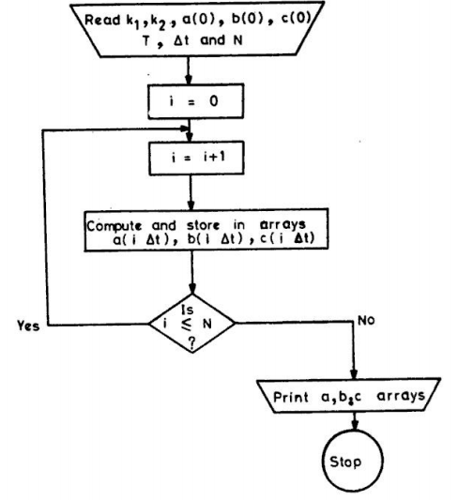

Slide 14
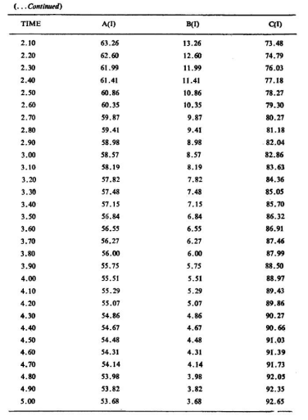
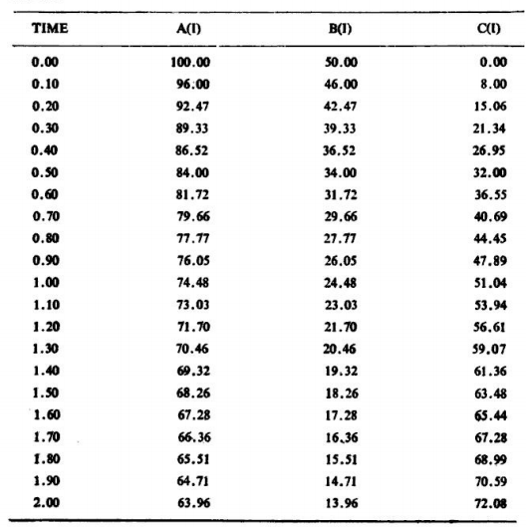
Sample output

